Slide 1

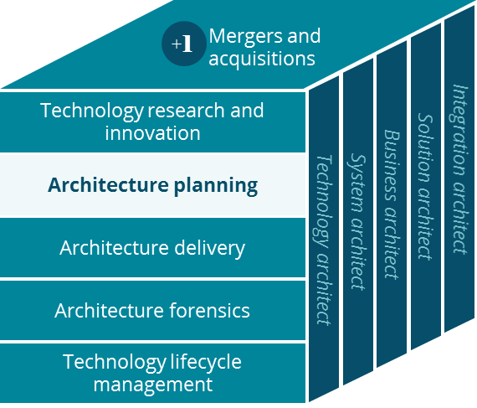
Retail Front-store Business Canvas
Architecture Planning
Ravi Vangala
4/3/2019

Slide 2
Retail Front-store Business Canvas
Holistic view of the current Retail front-store business model
Key Partnerships
Key Activities
Value Proposition
Customer Relationships
Customer Segment
OTC medication consultation
Home delivery
Self-care + Sick-care
at 10,500+ stores across the nation and in local communities
Individual consumers
US domestic population.
Distributors & Suppliers
Curb side pickup
Health HUB & care concierge
Self-care Retail merchandising:
Over-the-counter medications, personal care products, wellness products, beauty and cosmetic products, healthy food and general merchandise
Self-care patients
Manufacturers
Inventory management
Photo, contact lenses services
Health HUB partners?
Key Resources
Channels
Product portfolio
Store staff
In person
Email
Local real-estate
Health HUB products & svs.
Phone
Web/ Mobile app
Supply-chain & Logistics
Vending machines
Text
Home delivery
Cost Structure
Revenue Streams
Store real-estate is very expensive especially in urban areas.
Sale of merchandising products and services
Store operations & supply chain
Sale of Health HUB services

